Slide 1
How to Do HW 3:
Simulations
Using Runge-Kutta Methods of the
Kinematic Bicycle Model
ME 452 – Vehicle Dynamics, Fall 2026

Slide 2
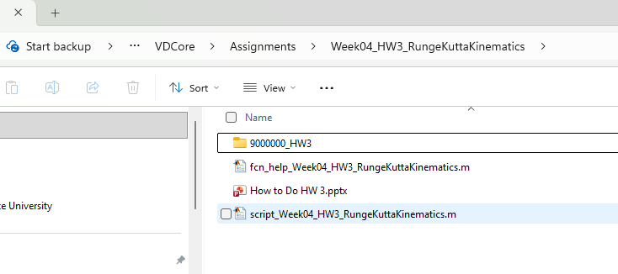
First step: create a folder to work from for this homework (HW3 in this example)
In the homework assignments, we will need a place to save our scripts and, later, our own functions. By default, the “Assignments” folder and all subfolders that exist when running the main script are set to be visible to MATLAB. The suggestion for this assignment, and all future assignments, is to keep each assignment’s scripts, folders, data files in a sub-folder within each assignment. It’s suggested that the name match your Canvas student number and indicate which homework is being completed. For example, see the folder for Dr. B whose number is 9000000

Slide 3
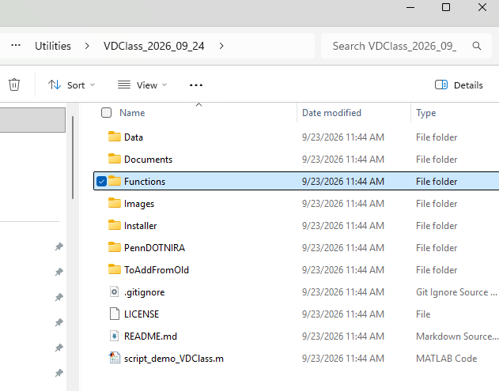
Unlike in previous assignments where scripts were given, in this assignment we ask students to use an existing script and copy/paste from it into their own scripts
The scripts that show how to use various vehicle dynamic simulations are in the “Utilities” subfolder, specifically in the Vehicle Dynamic codes (called a “class” of codes). The name is “VDClass” with the date of the most recent version. See the example at right:

Slide 4
The scripts we will use in this semester can be found in the “Functions” subfolder.
There’s a folder for each type of model. Note: this is an active area of research in Dr. B’s group, so the list grows and changes even throughout the semester. There are generally 3 types of codes for each type of model:
MATLAB Runge-Kutta ← We’ll use these primarily (easiest)
Simulink Runge-Kutta
Python codes (these are for real-time implementations)
There is a subfolder of Comparison Scripts that run the MATLAB and Simulink versions side-by-side to show that they give exactly the same results

Slide 5
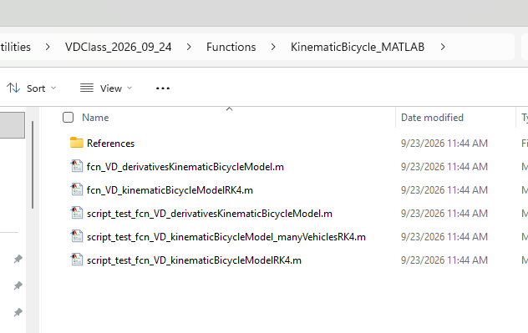
The scripts we will use for this homework are those for the kinematic bicycle model
This is a model of the 2-wheel vehicle (the “bicycle” model) driving at very low speeds such that no tires slip. It is kinematic because we can solve for the position of the vehicle without using dynamics (Newton’s laws). It can be found in the sub-folder of the same name

Slide 6
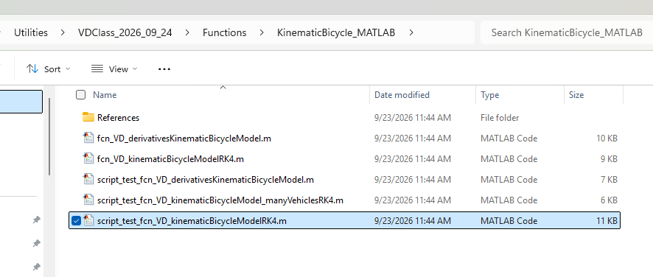
The specific script we want to grab code from is in the “script_test_....” file.
See:
script_test_fcn_VD_kinematicBicycleModelRK4

Slide 7
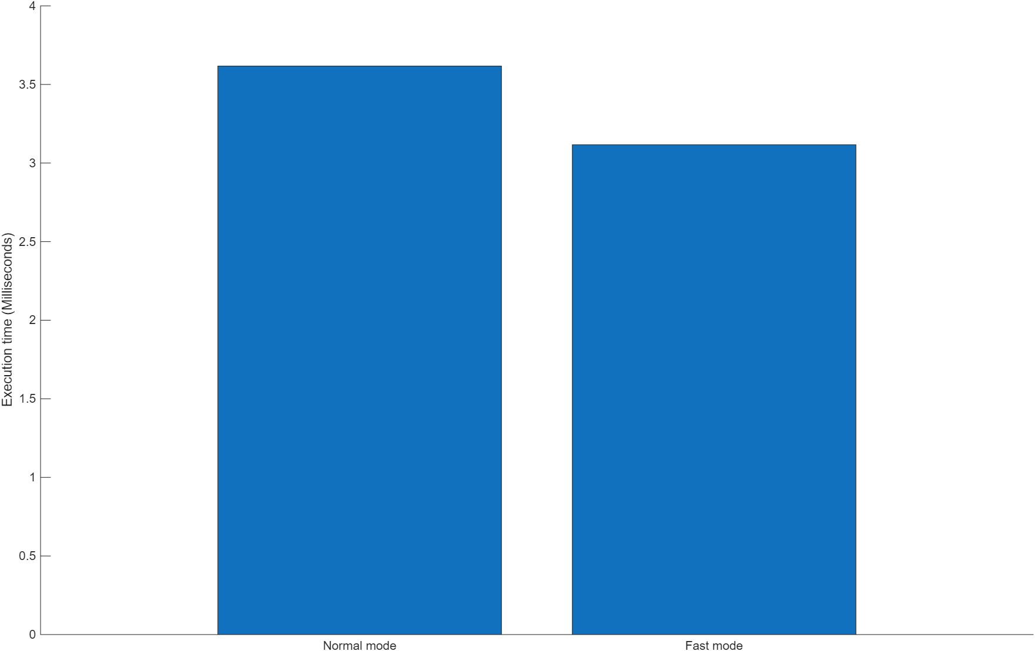
Assuming you have already run the main 2026Fall script (which installs this library), you should be able to run the script.
Each section performs a different demonstration or test of the code, and the final section compares the speed of the code between two variations, a fast and slow mode. The difference is that the fast mode skips some tests in the code that make sure the inputs are correct. We can see the code runs in about 3 ms on Dr. B’s computer.

Slide 8
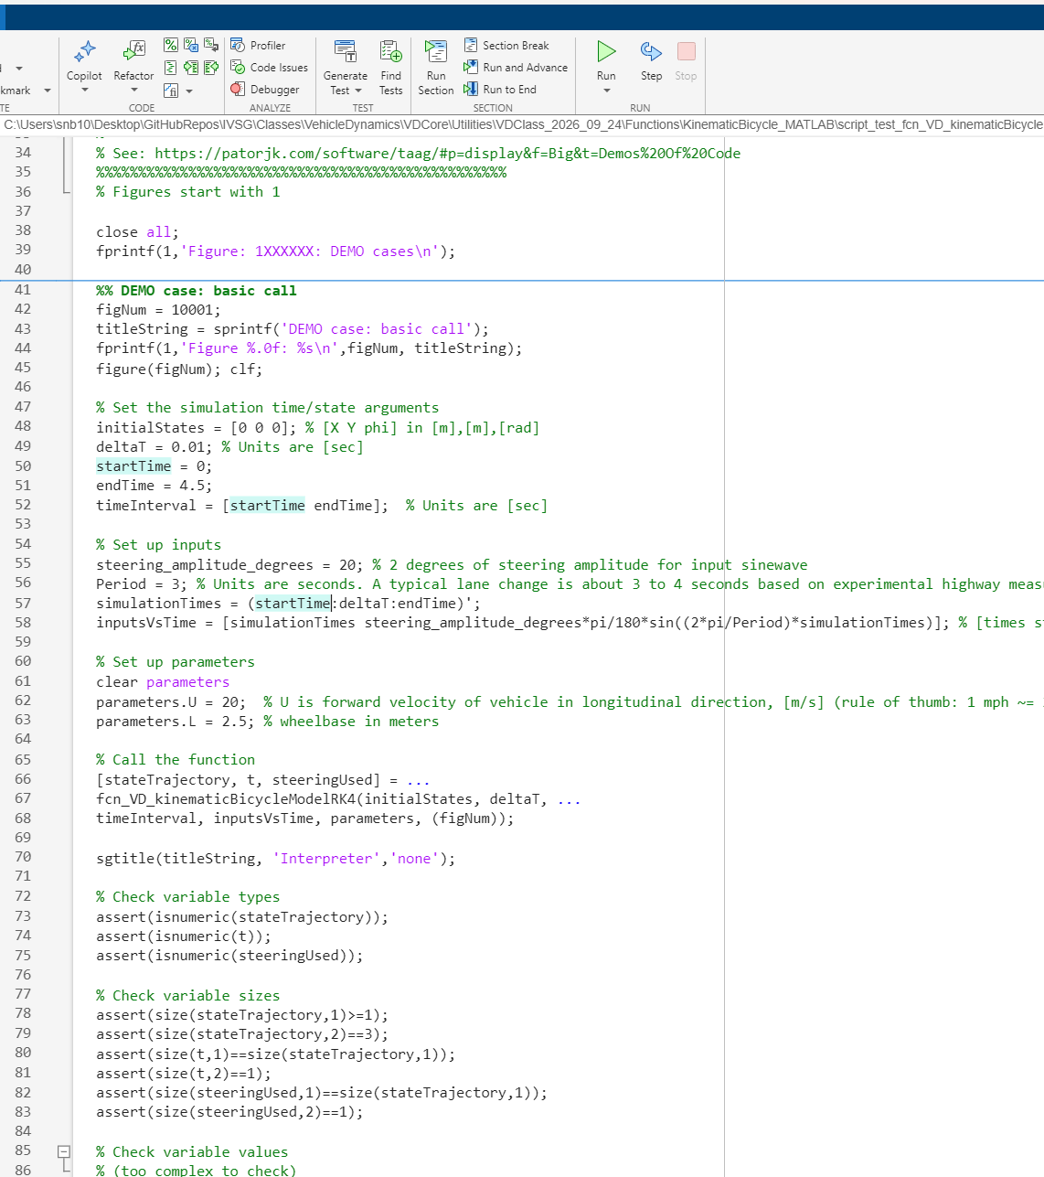
Each section of code has “assertions”. These are tests in the code that check that the outputs of the code are exactly as they should be.
This is VERY good programming practice. Quite often, someone will change a script to fix a bug, but the “fix” breaks the code in other ways. The assertions confirm that, for all the ways the code is expected to work (called “tests”), the code passes.
For example: for production codes for autonomous vehicles, each code set may have to pass millions of tests before release.

Slide 9
Lesson: if our code does not have tests, it is not ready for use on a vehicle
The most basic types of tests are shown here:
Types: Make sure the output is of the right type (integers, strings, logical)
Sizes: Make sure the output is of the right size using the “size” command (an array of 2 rows and 10 columns, for example)
Values: Make sure the values of the outputs are as expected (for example: a function that “adds” gives a value of 4 when asked to perform 2+2)

Slide 10
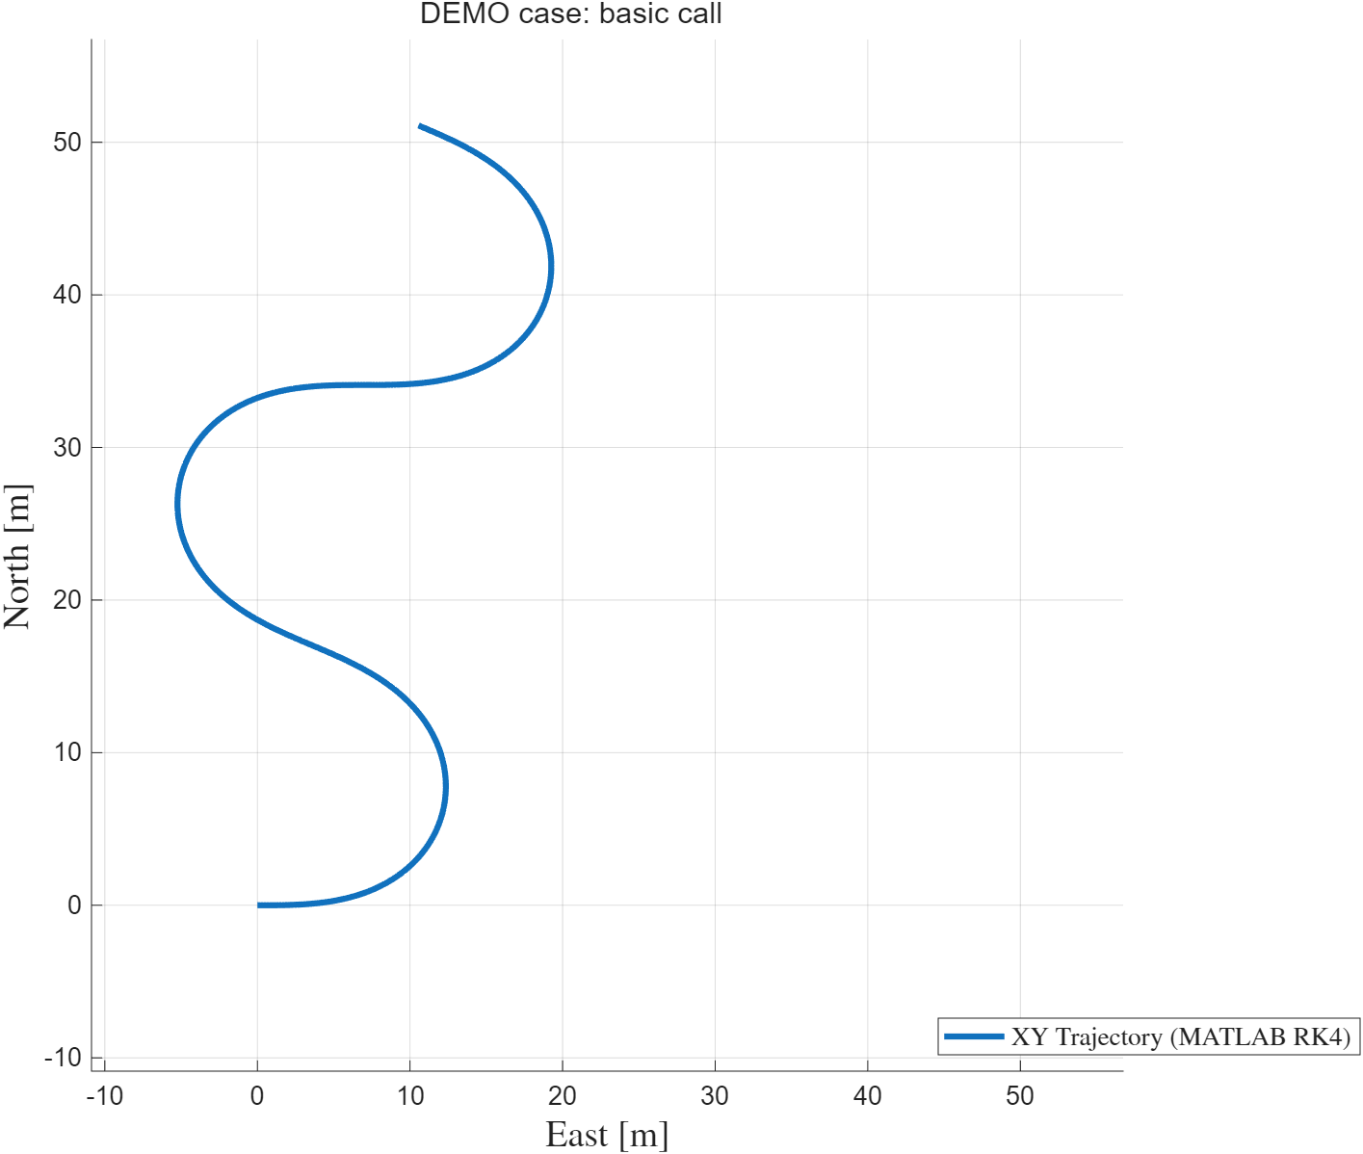
The “basic call” section can be run by itself by clicking into it and running “run section” at top
It produces a plot of the vehicle following a sinewave steering input

Slide 11
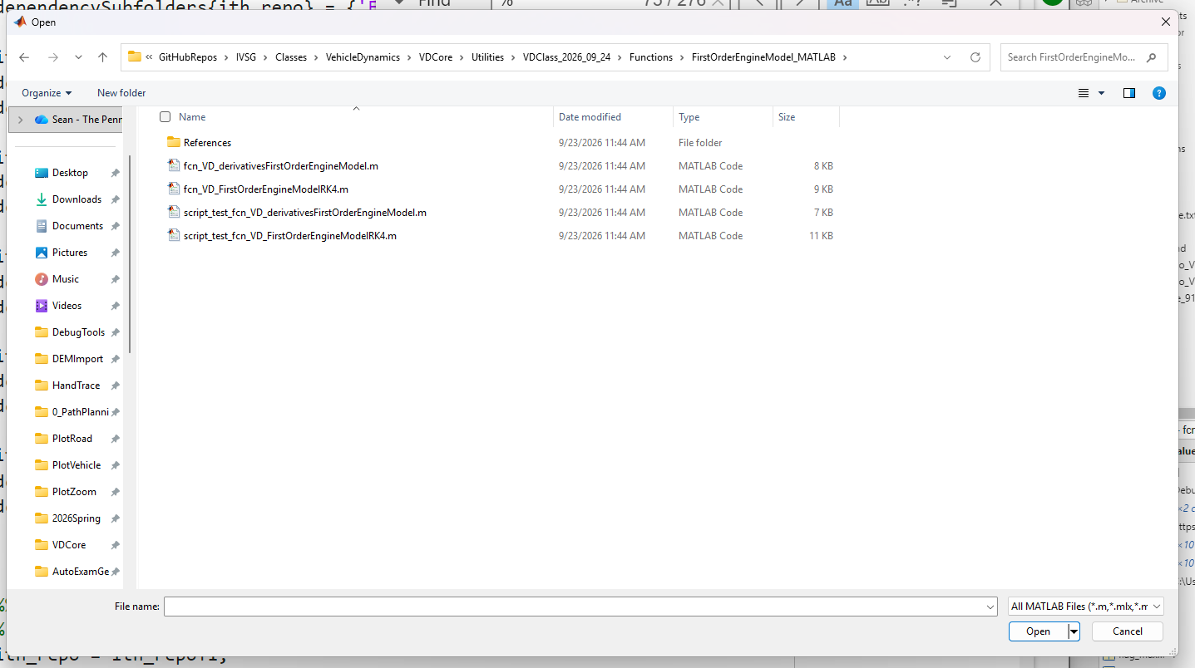
Note: this script was taken from an example from the vehicle library, which you have a copy within your Utilities subfolder
We will be using functions and scripts out of this library increasingly throughout the semester

Slide 12
For our homework, we want to copy / paste the example parts of interest into our code
The part of interest is where it shows the definition of the inputs and an example of how the function is called

Slide 13
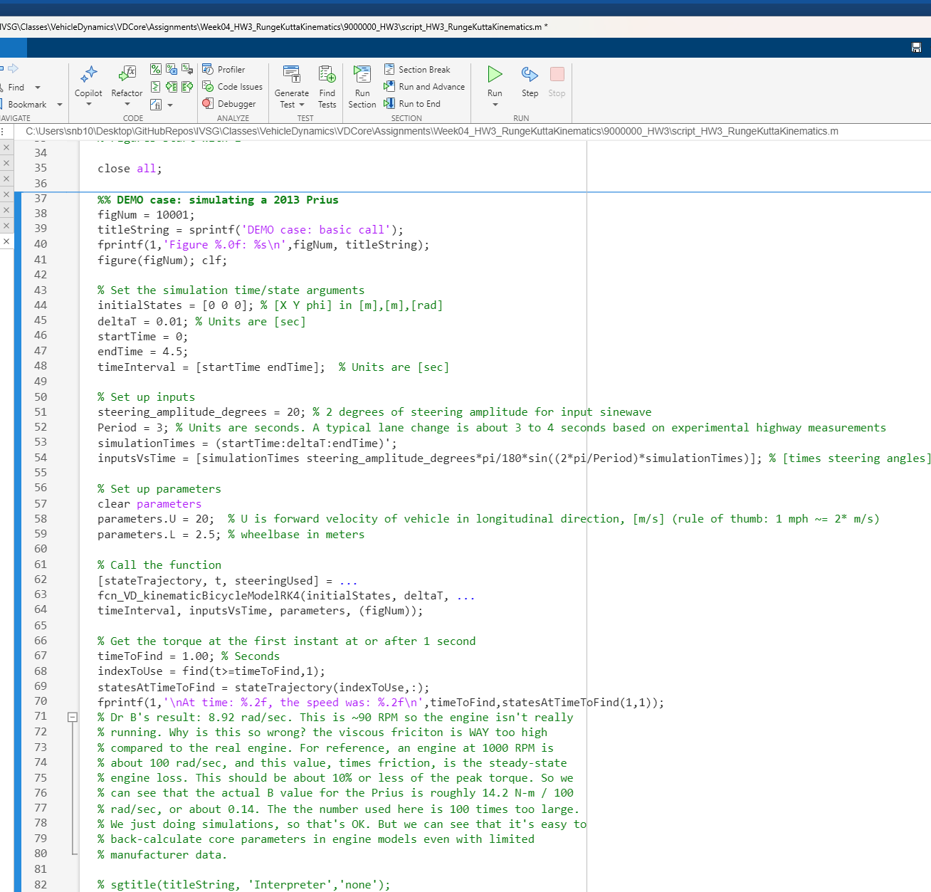
To code this HW, it is a good idea to start with the script we used in the last homework, and just copy/paste into this, using it as our template
Here’s a screen copy of the results, for Dr. B’s code

Slide 14
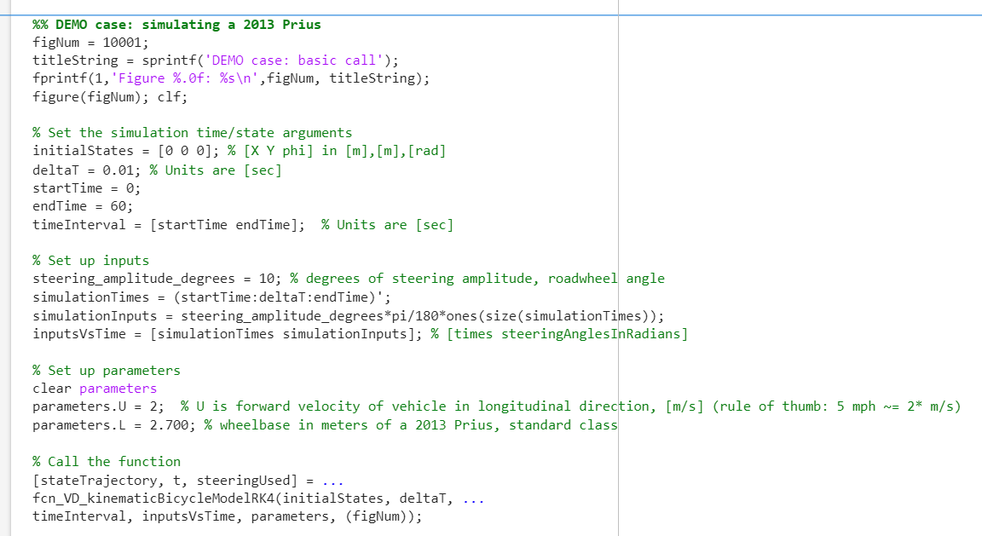
Now, we must change the inputs to fit the assignment.
We want 60 seconds of time total
We want the input to be a constant steering input (we create this by multiplying an array of “1” values by the steering amplitude we want)
For your steering input, use the 2nd number of your Canvas ID. If your 2nd number is 0, use 10 degrees. For example, if your number is 7, use 7 degrees.
We want the speed to be 2 m/s
We want the length of our vehicle to match the wheelbase for our specific vehicle. Enter yours here.
Each student’s vehicle length will be different, so each simulation’s results will be different!

Slide 15
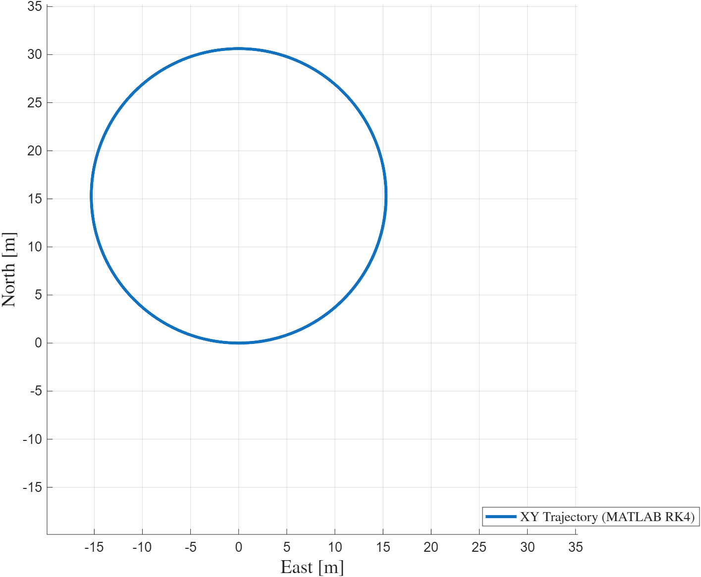

Finally, we must run the script section that does the simulation.
As expected, the vehicle drives in a circle
The expected radius is given by our kinematic steering angle formula
$$\tan\left(δ_{f}\right)=\frac{L}{R}$$

Slide 16
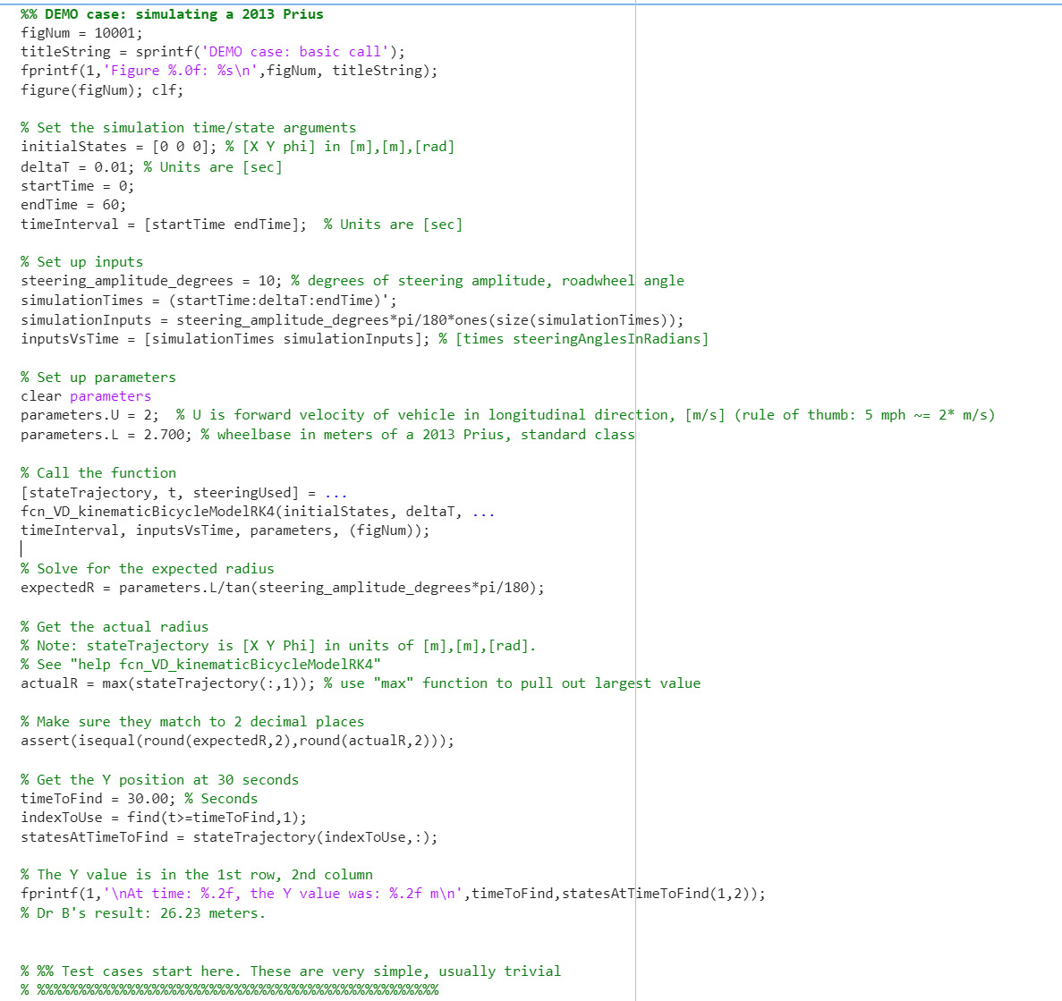
We can add code to check this using an assert command (again, this is good practice).
The prediction and simulation should agree to at least 2 decimal places (actually, they agree almost perfectly)

